Slide 1
Agents in Artificial Intelligence

Slide 2
Agents
An agent is a system or entity that is capable of perceiving its environment, making decisions, and taking actions to achieve specific goals.
Agents can be software programs, robots, or any other entities that interact with their surroundings to achieve desired outcomes
The agents sense the environment through sensors and act on their environment through actuators
An AI agent can have mental properties such as knowledge, belief, intention, etc.

Slide 3
Types of Agents
An Agent runs in the cycle of perceiving, thinking, and acting
An agent can be:
Robotic Agent: A robotic agent can have cameras, infrared range finder, NLP for audio sensors and motors for actuators.
Vacuum cleaner robot
Software Agent: Software agent can have keystrokes, file contents as sensory input and act on those inputs and display output on the screen.
Chat bots

Slide 4
Types of Agents
Game Playing Agents: AI agents designed to play games like chess, Go, and poker against human opponents or other AI agents.
Fritz, Stockfish, etc
Autonomous Agents: Agents used in scenarios like search and rescue missions, where they navigate complex environments without human control.
Autonomous delivery robots

Slide 5
Agent Environment in AI
An environment is everything in the world which surrounds the agent, but it is not a part of an agent itself. An environment can be described as a situation in which an agent is present.
The environment is where agent lives, operate and provide the agent with something to sense and act upon it. An environment is mostly said to be non-feministic.

Slide 6
Agent Components
Sensor: Sensor is a device which detects the change in the environment and sends the information to other electronic devices. An agent observes its environment through sensors.
Actuators: Actuators are the component of machines that converts energy into motion. The actuators are only responsible for moving and controlling a system. An actuator can be an electric motor, gears, rails, etc.
Effectors: Effectors are the devices which affect the environment. Effectors can be legs, wheels, arms, fingers, wings, fins, and display screen

Slide 7
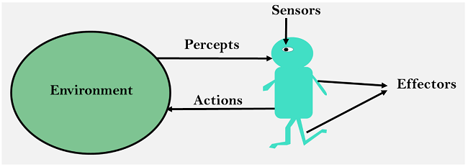
Agent

Slide 8
Intelligent Agents
An intelligent agent is an autonomous entity which act upon an environment using sensors and actuators for achieving goals
An intelligent agent may learn from the environment to achieve their goals
A thermostat is an example of an intelligent agent.

Slide 9
Following are the main four rules for an AI agent:
Rule 1: An AI agent must have the ability to perceive the environment.
Rule 2: The observation must be used to make decisions.
Rule 3: Decision should result in an action.
Rule 4: The action taken by an AI agent must be a rational action.

Slide 10
Rational Agent
A rational agent is a mathematical model that tries to represent the behavior of an intelligent being, like a person or animal
An agent which has clear preference, models uncertainty, and acts in a way to maximize its performance measure with all possible actions.
Perform the right things. AI is about creating rational agents to use for game theory and decision theory for various real-world scenarios.
For an AI agent, the rational action is most important because in AI reinforcement learning algorithm, for each best possible action, agent gets the positive reward and for each wrong action, an agent gets a negative reward.

Slide 11
Rationality
The rationality of an agent is measured by its performance measure
Rationality can be judged on the basis of following points:
Performance measure which defines the success criterion.
Agent prior knowledge of its environment.
Best possible actions that an agent can perform.
The sequence of percepts.

Slide 12
Structure of an AI Agent
The task of AI is to design an agent program which implements the agent function.
The structure of an intelligent agent is a combination of architecture and agent program.
It can be viewed as:
Agent = Architecture + Agent program

Slide 13
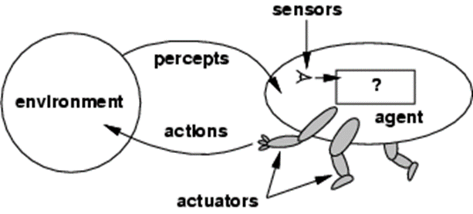
Structure of an AI agent
Architecture: Architecture is machinery that an AI agent executes on.
Agent Function: Agent function is used to map a percept to an action. f:P* → A
Agent program: Agent program is an implementation of agent function. An agent program executes on the physical architecture to produce function f.

Slide 14
PEAS Representation
Type of model on which an AI agent works upon
When we define an AI agent or rational agent, then we can group its properties under PEAS representation model
It is made up of four words:
P: Performance measure
E: Environment
A: Actuators
S: Sensors

Slide 15
PEAS
Performance: Safety, time, legal drive, comfort
Environment: Roads, other vehicles, road signs, pedestrian
Actuators: Steering, accelerator, brake, signal, horn
Sensors: Camera, GPS, speedometer, odometer, accelerometer, sonar.

Slide 16
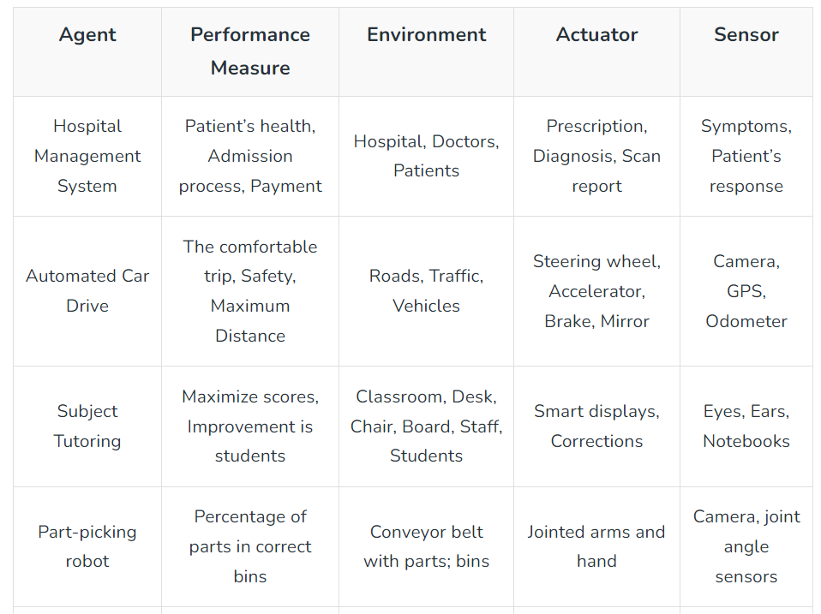
PEAS

Slide 17
THANK YOU

